Slide 1
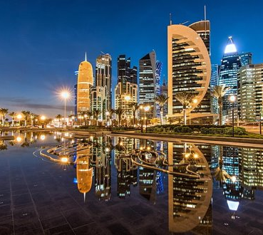

Travel Expense Reimbursement

Slide 2
1
Overview
Findings
Agenda
2
Difficulties
3
Information Modeling Technique/ Tool

Slide 3



Overview of Application Domain
Background
Analysis
Applicable Info
Travel Procurement Card payment of travel-related expenses, Program started for University of Kentucky to support employees for University trips
Getting to know about the travelers and travel arrangers; working on organizing the responsibilities, policies, trips and expenses to follow the set of procedures that University had applied with EER and Neo4j
Organizing and collecting information on Restrictions on Travel Reimbursement, submitting reports for expenses, Knowing about approving authority, policies to follow applicable for travel management
The University provides a Travel Reimbursement card program for business travelers to get reimbursed for trip expenses, with conditions and policies to follow.

Slide 4
Difficulty with Entity Relationship Diagram and Relational Schema
Identifying Relationships
Identifying Valuable Information
Filtering Information
Overcame Difficulty
Working with entities and attributes was tricky as the information has several important features to be considered
The information on policies, trips, agencies, procedures, dos and don’ts had complex relationships and interconnection that was hard to define concisely at first
More information led to large EER which didn’t show clear relationships leading to confusion which had similar impact on schema
We followed team recommendations to assign roles and conducted individual document analyses to uncover diverse views
The creation of an EER diagram and Relational schema, along with designing working queries to extract accurate data, necessitated teamwork, analysis, and collaboration to produce a concise and meaningful diagram for the document.

Slide 5
Difficulties Data and Graph Databases
Unable to display properties in graph mode, resulting in the output being returned in table form
Importing external libraries like apoc caused the Neo4j database to stop functioning if the configuration file was changed
Insufficient data forced switching to favoured vendor to infer each traveler's chosen meal

Slide 6
Information Modeling Tool/Technique
Recommendation
Reasons
Support
We recommend using Enhanced Entity Relationship Diagrams (EERD) as it allows us to represent complex relationships between entities and their attributes accurately.
EERD allows us to consider different scenarios and their attributes, making it suitable for travel reimbursement management.
EERD in our project to model the reimbursement process, which helped in identifying unique identifiers, creating a detailed schema, and representing complex relationships accurately.
The creation of an EER diagram the large amount of data and relations were easily simplified and thus even if more information is added it wouldn't be difficult for use to analyse it.

Slide 7

Thank you.
Open for Questions?

